Slide 1

Loan default prediction
A presentation by Om Pandey

Slide 2

Understanding the Problem
Loan default prediction is a binary classification problem where the objective is to estimate the probability that a borrower will default on the loan. Key challenges include:
Highly imbalanced dataset (default ~8–10%)
Mixed data types (numeric, categorical, ordinal, binary)
Missing values across important features
Skewed distributions, strong outliers
Potential high-cardinality categories
Multiple correlated risk scores (Score_Source_1/2/3)

Slide 3


Proposal
Follow a fool-proof ML-Workflow
Data Preprocessing
Feature Engineering
Handling Imbalanced data
Training ML-Models
Model Evaluation
Business Solution/ Insights
System Design

Slide 4

Data Preprocessing
Handled missing values using:
Mean for numeric (<10% missing)
Mode for categorical (<10%)
Added missingness indicator columns for high-missing-risk attributes (e.g., Score_Source_1_missing, House_Own_Age_Missing)
Cleaned data types and enforced correct categories
Identified high-cardinality categorical columns
Outlier handling:
Binning for skewed variables (Own_House_Age_bin)
Log-transform planned for extremely skewed numeric attributes

Slide 5

Feature Engineering
Label encoding categorical features
Binned house age
Derived missing indicators
Stratified splitting: 70/15/15
No scaling needed for tree models (our primary models)

Slide 6

Handling Imbalanced data
Used:
Stratified splits
Tuned classification threshold
Top-5% recall metric
Tree models inherently handle imbalance (through scale_pos_weight)

Slide 7
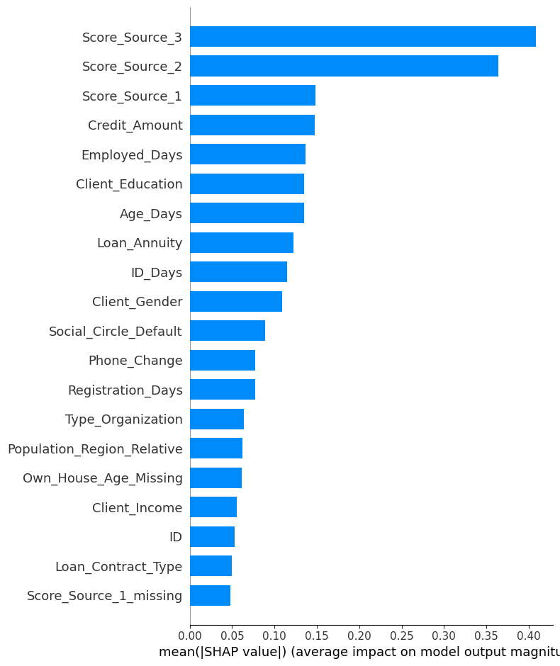
Feature Importance
Top Predictive Features
Score_Source_3
Score_Source_2
Score_Source_1
Credit_Amount
Employed_Days
Client_Education
Age_Days
Loan_Annuity

Slide 8

Model Evaluation
Metrics tracked:
Accuracy — not important for imbalance
AUC-ROC — how well the model separates defaulters & non-defaulters
Recall (Sensitivity) — how many true defaulters we detect
F1 Score — balance between precision & recall
Recall @Top 5% highest scores — crucial for loan-risk segmentation
SHAP explainability
Why Top-5% Recall?
Banks only look at the riskiest segment for manual review.
If the model can capture defaults within the top 5% predicted scores → business wins.
Best Model: LightGBM
AUC: 0.755
Recall: 0.840
F1: 0.216
Recall @Top5%: 0.208

Slide 9

Business Solution / Insights
How the bank can use this model?
Automated pre-screening
Approve low-risk borrowers automatically
Manual review for high-risk top 5%
Dynamic loan pricing
Higher interest rate for borderline cases
Targeted credit-building programs
Employment stability
Financial literacy
Lower-income customers benefit from guidance
Financial Impact
Reduction in NPAs
Increased approval accuracy
Lower manpower costs
Faster loan processing

Slide 10
System Design (MLOps + Architecture)
Feature Engineering
Monitoring
Data ingestion
Model Saving
Model Training
Preprocessing
Deploying Model

Slide 11
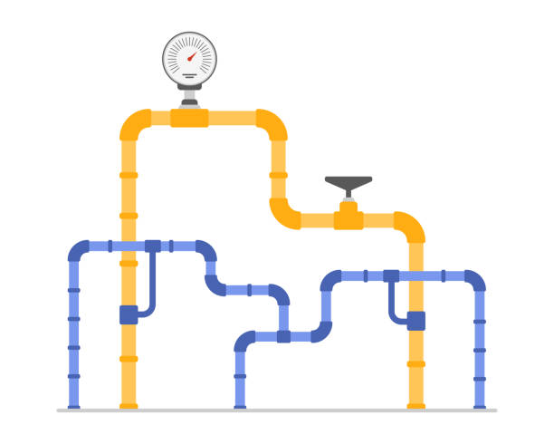
System Architecture for Production Deployment
Offline Pipeline
Data ingestion → validation → cleaning → feature engineering
Model training via MLflow + Optuna
Store artifacts in:
S3 (data + models)
MLflow Model Registry
Online Inference Pipeline
Containerized model (Docker/K8s)
Served via FastAPI or Flask
Deployed on:
AWS ECS/EKS
AWS Lambda
Or SageMaker Endpoint
Feature Store
SageMaker Feature Store
Ensures training-serving feature consistency

Slide 12
Build and Monitoring Strategies
Canary Build Strategy
Deploy new model to 5–10% of traffic
Monitor:
Drift
Latency
AUC on streaming labeled data
If stable → rollout to 100%
If unstable → automatic rollback
Model Monitoring Strategy
Monitor:
Prediction drift
Feature drift
Data quality issues
Model latency & throughput
Business KPIs: default rate, approval rate
Tools:
Evidently AI
AWS SageMaker Model Monitor
Alerts triggered on:
AUC drop
Sudden spike in predicted default rate
Missing values in key features

Slide 13
Security & Governance
Data Security
Data encryption in transit (TLS 1.2+) and at rest (AES-256)
PII masking / tokenization for sensitive attributes
RBAC with IAM to restrict dataset and model access
Model Security
Versioned, signed models stored in MLflow Model Registry
API authentication via OAuth2/JWT + rate limiting
Input validation to prevent adversarial/model-probing attacks
Infrastructure Security
Deployment inside private VPC + subnet isolation
Secrets stored in Vault/Secrets Manager (no hard-coded creds)
Least-privilege access policies for all components
Governance & Compliance
Model cards, SHAP reports, and full lineage tracking
MLflow auditing (params, metrics, data versions)
Compliance with RBI Fair Lending, GDPR, Responsible AI
Regular bias, fairness, and drift monitoring

Slide 14


